Slide 1
7 – Protocols
Marian Marinov
CEO of 1H Ltd.
mm@1h.com
Borislav Varadinov
System Administrator
bobi [ at ] itp.bg

Slide 2
ARP/RARP
ICMP
UDP
TCP
TCP Congestion
SCTP
DCCP
DNS

Slide 3
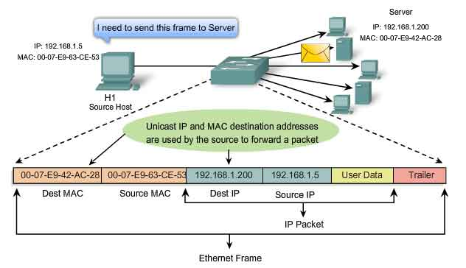
Type of requests - Unicast

Slide 4
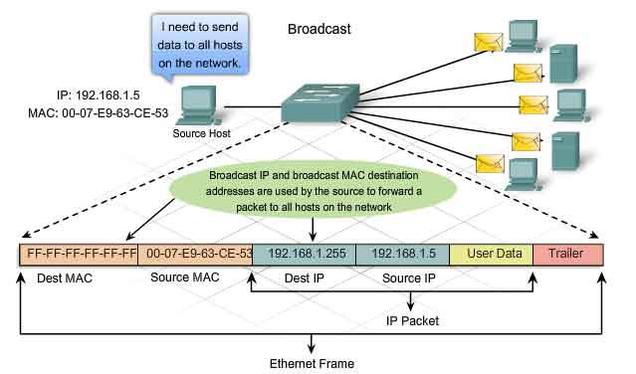
Type of requests - Broadcast

Slide 5
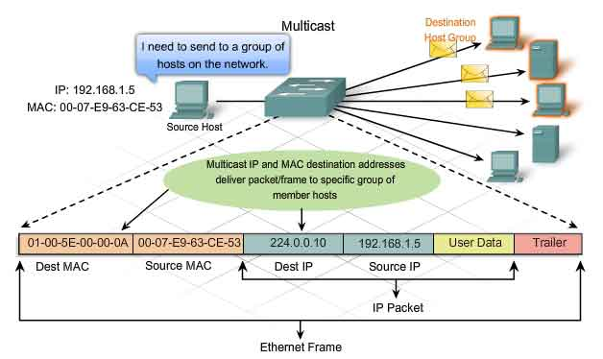
Type of requests - Multicast

Slide 6
Address Resolution Protocol
Address resolution
  Forward
  Reverse
ARP
  Probe
  Proxy
  Mediation
  Stuffing

Slide 7
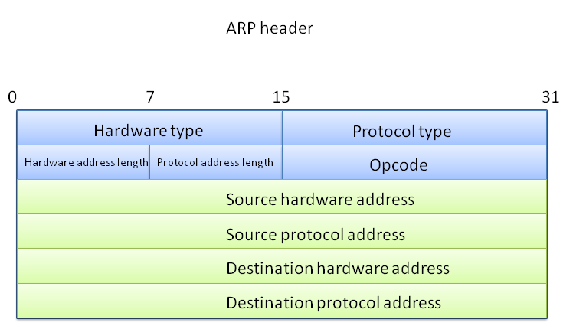
Address Resolution Protocol
Address resolution
  Forward (what is the MAC of this machine)
Request
0x0800
1 - req
2 - reply
08:11:96:03:B2:28
192.168.2.254
FF:FF:FF:FF:FF:FF
192.168.2.58

Slide 8
Address Resolution Protocol
Address resolution
  Forward (what is the MAC of this machine)
Reply
40:b3:95:80:c5:aa
192.168.2.58
08:11:96:03:b2:28
192.168.2.254

Slide 9
Address Resolution Protocol
Address resolution
  Reverse (what is the IP of this machine)
Request
08:11:96:03:B2:28
192.168.2.254
40:b3:95:80:c5:aa
0.0.0.0

Slide 10
Address Resolution Protocol
Address resolution
  Reverse (what is the IP of this machine)
Reply
40:b3:95:80:c5:aa
192.168.2.58
08:11:96:03:B2:28
192.168.2.254

Slide 11
Address Resolution Protocol
How it actually looks
15:12:43.772954 ARP, Ethernet (len 6), IPv4 (len 4),
Request who-has 192.168.2.58 tell 192.168.2.254, length 28
15:12:43.962834 ARP, Ethernet (len 6), IPv4 (len 4),
Reply 192.168.2.58 is-at 40:b3:95:80:c5:aa, length 46
ARP probe
ARP proxy
ARP mediation
ARP stuffing

Slide 12
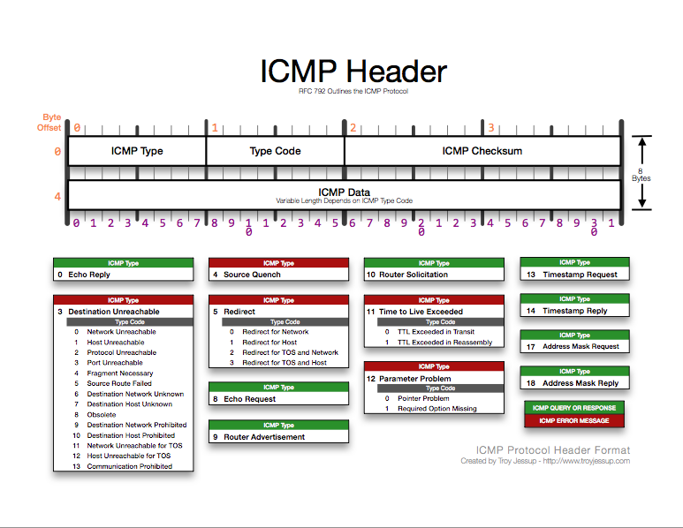
Internet Control Message Protocol - ICMP

Slide 13
Internet Control Message Protocol - ICMP
ICMP types
  0 – Echo replay
  1,2 – Reserved
  3 – Destination unreachable
  8 – Echo request
  9 – TTL Exceeded
  30 – Traceroute

Slide 14
Internet Control Message Protocol - ICMP
Type codes
11 – Time to live exceeded
0 – in transit
1 – in reassembly
3 – Destination unreachable
0 – network unreachable
1 – host unreachable
2 – protocol unreachable
3 – port unreachable
6 – network unknown
7 – host unknown
9 – network prohibited
10 – host prohibited

Slide 15
Protocol Encapsolation
Layer 4/5
TCP Header
IP Payload
Layer 3
IP Header
IP Payload
Layer 2
Layer 2
Ethernet Header
Ethernet payload

Slide 16
User Datagram Protocol - UDP
2
1
2
1
3
3
4
4
Machine X
Machine Y
UDP (RFC768 Jon Postel 1980)

Slide 17
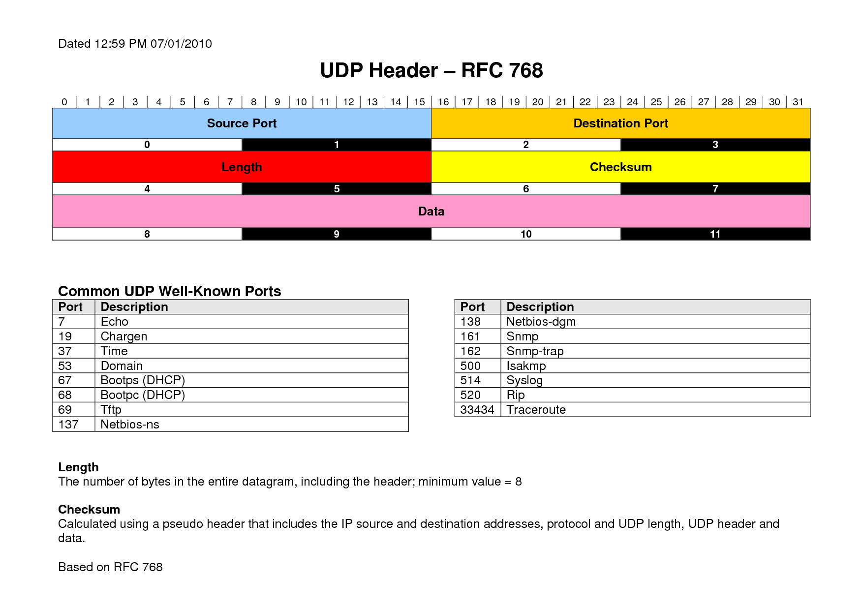
User Datagram Protocol - UDP

Slide 18
Transmission Datagram Protocol - TCP
2
1
2
1
3
3
4
UDP
4
2
1
2
1
3
3
4
TCP
4
Machine X
Machine Y
TCP (RFC793 Jon Postel 1981)

Slide 19
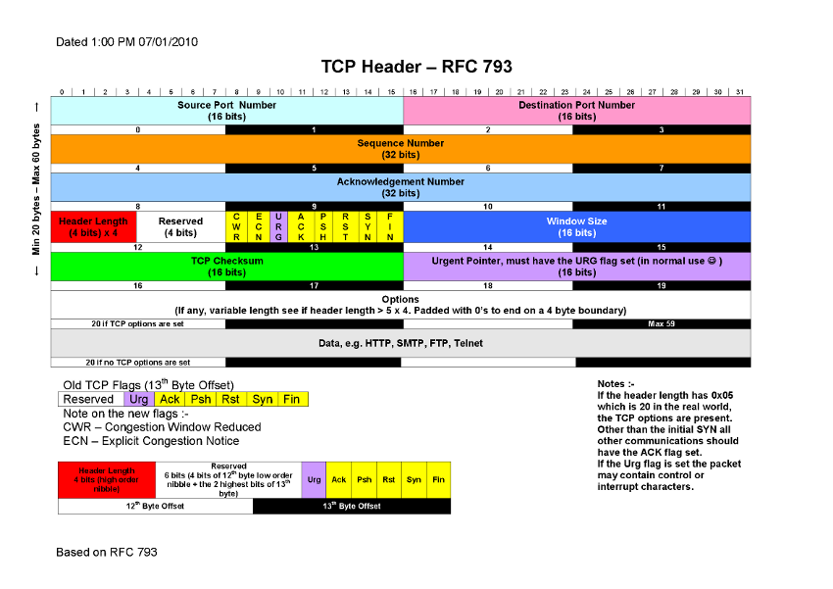
Transmission Datagram Protocol - TCP

Slide 20
Transmission Datagram Protocol - TCP
TCP (RFC793 Jon Postel 1981)
  Session establishment and tear-down
  Window procedure
  Slow start and congestion avoidance (Van Jacobson 1988)
  Fast open
  Syn cookies

Slide 21
Transmission Datagram Protocol - TCP
TCP
TCP
Process
Process
Machine Y
Machine X

Slide 22
Transmission Datagram Protocol - TCP
Three way handshake
Client
Server
Server
Flags: SYN Seq: X
SYN SENT
SYN RCVD
Flags: SYN, ACK
Flags: SYN, ACK
Established
Seq: Y, Ack: X+1
Flags: ACK
Seq: X + 1, Ack: Y+1
Established

Slide 23
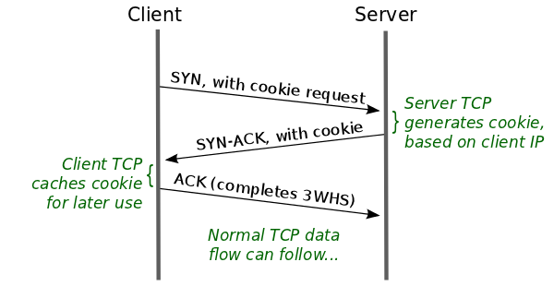
Transmission Datagram Protocol - TCP
TCP Fast open

Slide 24
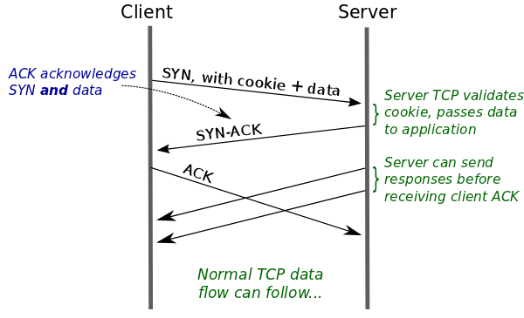
Transmission Datagram Protocol - TCP
TCP Fast open

Slide 25
Transmission Datagram Protocol - TCP
Connection Close
Client
Server
FIN WAIT 1
Flags: FIN Seq: X
CLOSE WAIT
Flags: FIN, ACK
FIN WAIT 2
LAST ACK
Seq: Y, Ack: X+1
Flags: ACK
Seq: X + 1, Ack: Y+1
CLOSE
TIME WAIT

Slide 26
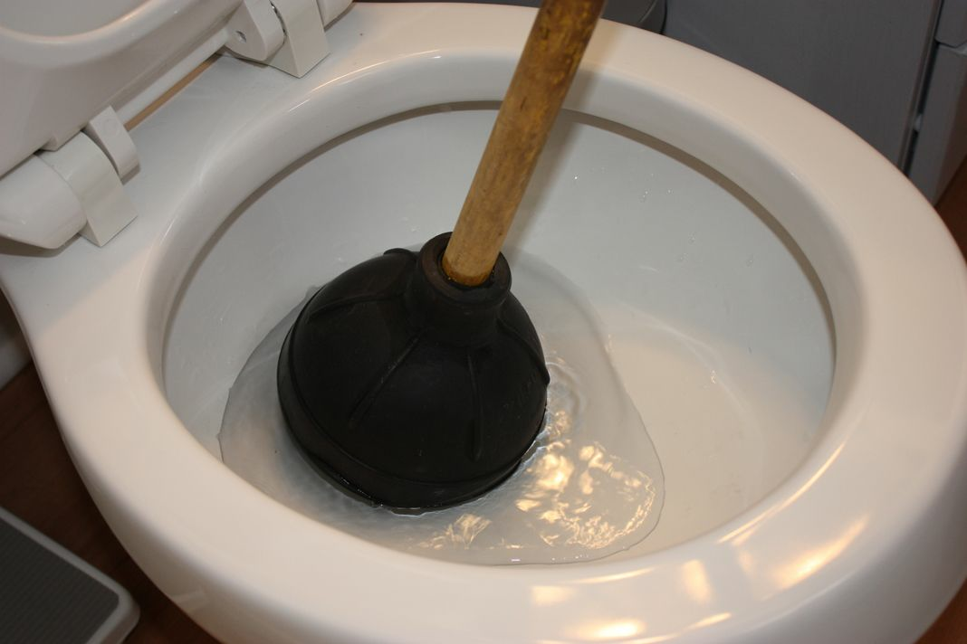
TCP Congestion
http://en.wikipedia.org/wiki/TCP_congestion_avoidance_algorithm

Slide 27
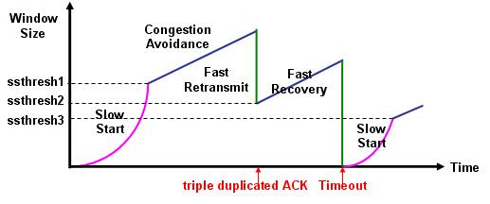
TCP Congestion
Slow start
Congestion avoidance
Fast retransmit
Fast Recovery

Slide 28
TCP Congestion – Slow start
The initial window size is initialized to one MSS
Each time a packet is ACKed the congestion window is
increased
When the ssthresh is reached, the next phase starts
http://en.wikipedia.org/wiki/Slow-start

Slide 29
TCP Congestion –
Congestion avoidance
In this phase window size is increased linearly until
timeout occurs or duplicate ACK is received

Slide 30
TCP Congestion – Fast retransmit
If more then 3 ACKs are received for the same segment the
the sender has to send that particular segment even before
its timer has expired
http://en.wikipedia.org/wiki/Fast_retransmit

Slide 31
TCP Congestion – Fast Recovery
In this phase window size is decreased to ssthresh rather
then the smaller initial value and increase its size linearly
http://histrory.visualland.net/tcp_fast_recovery.html

Slide 32
TCP Congestion Avoidance - Problems
Slow-start assumes that unacknowledged segments are
due to network congestion, which is usually NOT the case
in wireless networks, where dropped packets are mainly
because of poor data link quality.
The slow-start protocol performs badly for short-lived
connections, because it actually slows down the
transmission of data.
It is possible to trick the congestion avoidance algorithm
to think that the pipe is full and slow down all connections
originating from that machine.

Slide 33
TCP Keepalive
The keepalive packets are packets which contain no data
sent at regular interval to confirm that this connection is
alive
Keepalive time is the duration between two keepalive
transmissions in idle condition. TCP keepalive period is
required to be configurable and by default is set to no less
than 2 hours.
Keepalive interval is the duration between two successive
keepalive retransmissions, if acknowledgement to the
previous keepalive transmission is not received. Usually
around 75 seconds.
Keepalive retry is the number of retransmissions to be
sent out before declaring that remote end is not available.

Slide 34
Datagram Congestion Control Protocol
Basically DCCP is UDP with congestion control mechanism
It features
Unreliable flows of datagrams
Reliable handshakes for connection setup and teardown
Negotiation of a suitable congestion control mechanism
Acknowledgment mechanisms communicating packet loss
Path Maximum Transmission Unit (PMTU) discovery
RFC4340

Slide 35
DCCP header (x = 1)
0 1 2 3
0 1 2 3 4 5 6 7 8 9 0 1 2 3 4 5 6 7 8 9 0 1 2 3 4 5 6 7 8 9 0 1
+-+-+-+-+-+-+-+-+-+-+-+-+-+-+-+-+-+-+-+-+-+-+-+-+-+-+-+-+-+-+-+-+
| Source Port | Dest Port |
+-+-+-+-+-+-+-+-+-+-+-+-+-+-+-+-+-+-+-+-+-+-+-+-+-+-+-+-+-+-+-+-+
| Data Offset | CCVal | CsCov | Checksum |
+-+-+-+-+-+-+-+-+-+-+-+-+-+-+-+-+-+-+-+-+-+-+-+-+-+-+-+-+-+-+-+-+
| | |X| | .
| Res | Type |=| Reserved | Sequence Number (high bits) .
| | |1| | .
+-+-+-+-+-+-+-+-+-+-+-+-+-+-+-+-+-+-+-+-+-+-+-+-+-+-+-+-+-+-+-+-+
. Sequence Number (low bits) |
+-+-+-+-+-+-+-+-+-+-+-+-+-+-+-+-+-+-+-+-+-+-+-+-+-+-+-+-+-+-+-+-+
If X is 1 the Sequence Number field is 48 bits long

Slide 36
DCCP header (x = 0)
0 1 2 3
0 1 2 3 4 5 6 7 8 9 0 1 2 3 4 5 6 7 8 9 0 1 2 3 4 5 6 7 8 9 0 1
+-+-+-+-+-+-+-+-+-+-+-+-+-+-+-+-+-+-+-+-+-+-+-+-+-+-+-+-+-+-+-+-+
| Source Port | Dest Port |
+-+-+-+-+-+-+-+-+-+-+-+-+-+-+-+-+-+-+-+-+-+-+-+-+-+-+-+-+-+-+-+-+
| Data Offset | CCVal | CsCov | Checksum |
+-+-+-+-+-+-+-+-+-+-+-+-+-+-+-+-+-+-+-+-+-+-+-+-+-+-+-+-+-+-+-+-+
| | |X| |
| Res | Type |=| Sequence Number (low bits) |
| | |0| |
+-+-+-+-+-+-+-+-+-+-+-+-+-+-+-+-+-+-+-+-+-+-+-+-+-+-+-+-+-+-+-+-+
If X is 0 the Sequence Number field is 24 bits long
Data Offset - the offset from the start of the packet's DCCP header to the start of its application data area
CCVal - Defines the congestion control algorithm used
CCVal = 2 - TCP like congestion avoidance
CCVal = 3 - TCP friendly congestion avoidance
CsCov - Checksum Coverage determines the parts of the packet that are covered by the Checksum field.
Checksum – DCCP header checksum
Type – DCCP packet type
X - Extended Sequence Numbers (may be 0 or 1)

Slide 37
DCCP header
All currently defined packet types except DCCP-Request and DCCP-Data carry an Acknowledgment Number Subheader
When X=1, its format is:
+-+-+-+-+-+-+-+-+-+-+-+-+-+-+-+-+-+-+-+-+-+-+-+-+-+-+-+-+-+-+-+-+
| Reserved | Acknowledgment Number .
| | (high bits) .
+-+-+-+-+-+-+-+-+-+-+-+-+-+-+-+-+-+-+-+-+-+-+-+-+-+-+-+-+-+-+-+-+
. Acknowledgment Number (low bits) |
+-+-+-+-+-+-+-+-+-+-+-+-+-+-+-+-+-+-+-+-+-+-+-+-+-+-+-+-+-+-+-+-+
When X=0, only the low 24 bits of the Acknowledgment Number are transmitted, giving the Acknowledgment Number Subheader this format:
+-+-+-+-+-+-+-+-+-+-+-+-+-+-+-+-+-+-+-+-+-+-+-+-+-+-+-+-+-+-+-+-+
| Reserved | Acknowledgment Number (low bits) |
+-+-+-+-+-+-+-+-+-+-+-+-+-+-+-+-+-+-+-+-+-+-+-+-+-+-+-+-+-+-+-+-+

Slide 38
DCCP packet types
Type Meaning
---- -------
0 DCCP-Request
1 DCCP-Response
2 DCCP-Data
3 DCCP-Ack
4 DCCP-DataAck
5 DCCP-CloseReq
6 DCCP-Close
7 DCCP-Reset
8 DCCP-Sync
9 DCCP-SyncAck
10-15 Reserved

Slide 39



Multihoming
ISP m
ISP x
ISP j
ISP y
The Internet
ISP s

Slide 40
Stream Control Transmission Protocol
Multihoming support in which one or both endpoints of a connection can consist of more than one IP address, enabling transparent fail-over between redundant network paths.
Delivery of chunks within independent streams eliminate unnecessary head-of-line blocking
Path selection and monitoring
Validation and acknowledgment mechanisms protect against flooding attacks and provide notification of duplicated or missing data chunks.
Improved error detection suitable for Ethernet jumbo frames.

Slide 41
Stream Control Transmission Protocol
0 1 2 3
0 1 2 3 4 5 6 7 8 9 0 1 2 3 4 5 6 7 8 9 0 1 2 3 4 5 6 7 8 9 0 1
+-+-+-+-+-+-+-+-+-+-+-+-+-+-+-+-+-+-+-+-+-+-+-+-+-+-+-+-+-+-+-+-+
| Common Header |
+-+-+-+-+-+-+-+-+-+-+-+-+-+-+-+-+-+-+-+-+-+-+-+-+-+-+-+-+-+-+-+-+
| Chunk #1 |
+-+-+-+-+-+-+-+-+-+-+-+-+-+-+-+-+-+-+-+-+-+-+-+-+-+-+-+-+-+-+-+-+
| ... |
+-+-+-+-+-+-+-+-+-+-+-+-+-+-+-+-+-+-+-+-+-+-+-+-+-+-+-+-+-+-+-+-+
| Chunk #n |
+-+-+-+-+-+-+-+-+-+-+-+-+-+-+-+-+-+-+-+-+-+-+-+-+-+-+-+-+-+-+-+-+
RFC4960

Slide 42
Stream Control Transmission Protocol
Common Header
0 1 2 3
0 1 2 3 4 5 6 7 8 9 0 1 2 3 4 5 6 7 8 9 0 1 2 3 4 5 6 7 8 9 0 1
+-+-+-+-+-+-+-+-+-+-+-+-+-+-+-+-+-+-+-+-+-+-+-+-+-+-+-+-+-+-+-+-+
| Source Port Number | Destination Port Number |
+-+-+-+-+-+-+-+-+-+-+-+-+-+-+-+-+-+-+-+-+-+-+-+-+-+-+-+-+-+-+-+-+
| Verification Tag |
+-+-+-+-+-+-+-+-+-+-+-+-+-+-+-+-+-+-+-+-+-+-+-+-+-+-+-+-+-+-+-+-+
| Checksum |
+-+-+-+-+-+-+-+-+-+-+-+-+-+-+-+-+-+-+-+-+-+-+-+-+-+-+-+-+-+-+-+-+
RFC4960

Slide 43
IP & Domain allocation
  IANA – www.iana.org
    Number resources
      IP Addresses
      Autonomous System (AS)
      Protocol number assignments
    Domain assignments
      Root zone management
      gTLD database
      .int and .arpa domains
  IP registrars
    ARIN, LACNIC, Africa, APNIC, RIPE

Slide 44
IP & Domain allocation
  Regional Internet Registrar(RIR)
  Local Internet Registrar(LIR)
  There are two types of IP addresses that can be requested
    Provider dependent
      These you get from your ISP
    Provider independent
      You get them from the local LIR or the regional RIR
      These allocations can not be smaller then /24 networks
  Autonomous System (AS)
    Used for the BGP routing protocol
    Aggregated IP route announcements are made from and
    to them
    The corner stone of the Internet routing
    Look at http://www.youtube.com/watch?v=oK-lgjJhC48

Slide 45
Domain Name System - DNS
Everything was 'hosts':
127.0.0.1 localhost
192.168.0.174 store1
192.168.0.238 store2
192.168.0.244 store3
192.168.155.2 operations
192.168.155.149 zimbra0.siteground.com
193.107.36.190 sapport.bg www.sapport.bg
8.8.8.8 ns.google.com
89.25.120.31 google.com
89.25.120.24 www.google.com
Linux: /etc/hosts
Windows: C:\Windows\System32\drivers\etc\hosts

Slide 47
DNS
Internet Corporation For Assigned Names and Numbers
  IANA is now part of it
  Handles ccTLDs
  Handles gTLDs
  Handles the Root zone
Country level domains
  .bg, .co.za, .co.uk, .edu.us
Top-level domains
  .com, .net, .org, .edu, .gov, .mil
  .biz, .name, .info
Instances of J and L root servers are hosted in Sofia

Slide 48
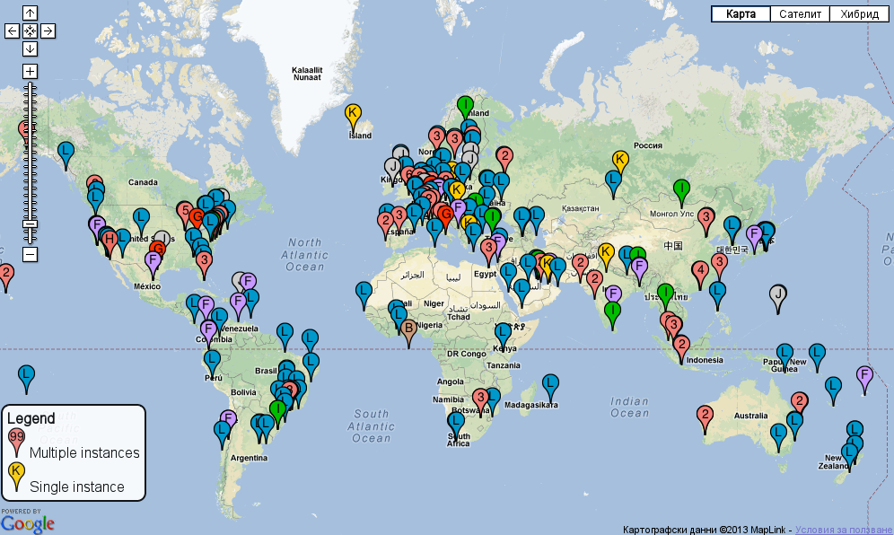
DNS

Slide 49
DNS
Internet Corporation For Assigned Names and Numbers
  IANA is now part of it
  Handles ccTLDs
  Handles gTLDs
  Handles the Root zone
Internationalized domain name (IDN)
  Domain names are encoded using Punycode
  .ru = .рф
  We are expecting soon .bg = .бг
Country level domains
  .bg, .co.za, .co.uk, .edu.us
Top-level domains
  .com, .net, .org, .edu, .gov, .mil
  .biz, .name, .info

Slide 50
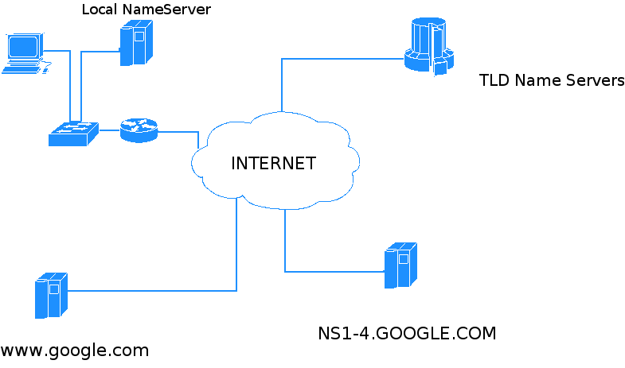
DNS
Name servers
  Authoritative only
  Recursive
  Authoritative + recursive
.in-addr.arpa
.ip6.arpa

Slide 51
DNS - Resolving
Default service port TCP/UDP: 53

Slide 52
DNS - Resolving
Forward resolving
  Host/FQDN to IP
Reverse resolving
  IP to Host
Reverse resolver delegation
  RIR -> LIR -> Local ISP -> YOU

Slide 53
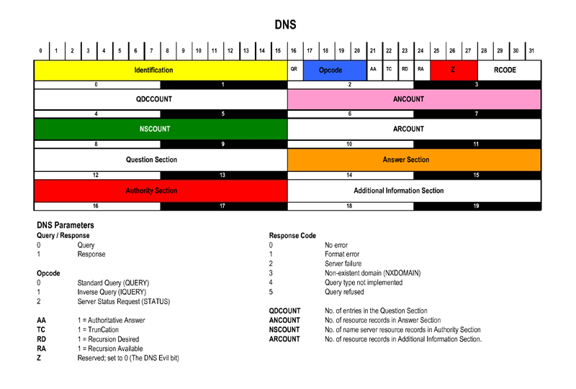
DNS

Slide 54
DNS Resource records
TYPE value and meaning
A 1 a host address
NS 2 an authoritative name server
CNAME 5 the canonical name for an alias
SOA 6 start of a zone of authority
WKS 11 a well known service description
PTR 12 a domain name pointer
HINFO 13 host information
MINFO 14 mailbox or mail list information
MX 15 mail exchange
TXT 16 text strings
AXFR 252 A request for a transfer of an
entire zone
RFC1035

Slide 55
DNS Resource records
kar-do.cc. 86400 IN SOA ns1.ex1.com.
mm.yuhu.biz. (
2013013106 ;Serial Number
86400 ;refresh
7200 ;retry
3600000 ;expire
86400 ;minimum
)
kar-do.cc. IN NS ns1.ex1.com.
kar-do.cc. IN NS ns2.ex1.com.
kar-do.cc. IN A 134.154.23.12
localhost IN A 127.0.0.1
kar-do.cc. IN MX 0 mail.kar-do.cc.
mail IN CNAME mail.yuhu.biz.
www IN A 134.154.23.12
www IN A 134.142.65.81
kar-do.cc. IN TXT
"v=spf1 +a +mx +ip4:134.154.23.12 ?all"

Slide 56
Send Mail Transport Protocol - SMTP
RFC5321

Slide 57
Send
Mail
Transport
Protocol
-
SMTP
S: 220 smtp.example.com ESMTP Postfix
C: HELO relay.example.org
S: 250 Hello relay.example.org, I am glad to meet you
C: MAIL FROM:<bob@example.org>
S: 250 Ok
C: RCPT TO:<alice@example.com>
S: 250 Ok
C: RCPT TO:<theboss@example.com>
S: 250 Ok
C: DATA
S: 354 End data with <CR><LF>.<CR><LF>
C: From: "Bob Example" <bob@example.org>
C: To: "Alice Example" <alice@example.com>
C: Cc: theboss@example.com
C: Date: Tue, 15 January 2008 16:02:43 -0500
C: Subject: Test message
C:
C: Hello Alice.
C: This is a test message with 5 header fields and 4 lines in the message body.
C: Your friend,
C: Bob
C: .
S: 250 Ok: queued as 12345
C: QUIT
S: 221 Bye
{The server closes the connection}

Slide 58
HTTP
In this phase window size is increased linearly until
timeout occurs or duplicate ACK is received

Slide 59

7 - Protocols
http://academy.telerik.com/student-courses/software-technologies/os-windows-linux/

Slide 60

Beer time

Slide 61



Free Trainings @ Telerik Academy
Operating Systems @ Telerik Academy
http://telerikacademy.com/Courses/Courses/Details/35
  Telerik Software Academy
    academy.telerik.com
  Telerik Academy @ Facebook
    facebook.com/TelerikAcademy
  Telerik Software Academy Forums
    forums.academy.telerik.com

